Slide 1
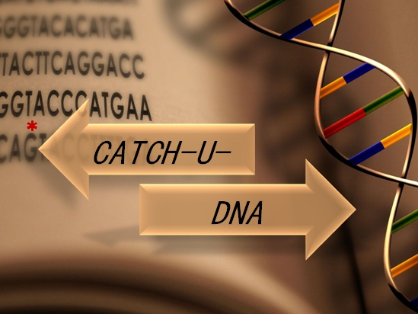
Madrid - 2/12/2018
Notes:
<number>

Slide 2
Objective:
to increase the Acoustic signal to lower down the Limit-of-detection
NAv
DNA
Liposomes
Δf (Hz)
(i)
(ii)
(iii)
Cholesterol
ΔD (10⁻⁶)
time (min)

Slide 3
Strategies:
Surface
decoration
Mechanical
Properties
Encapsulation
PEGs
~ 5 nm
Melting Temperature
(T_{m})
Leakage
Problems
Non-Specific
Signal

Slide 4
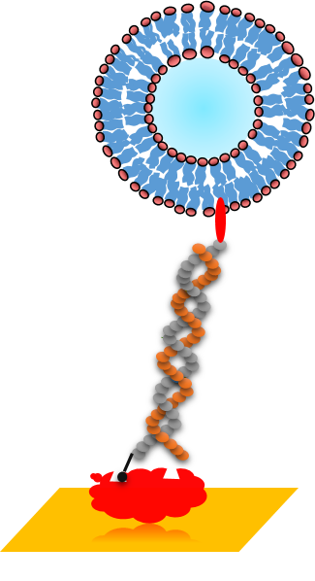
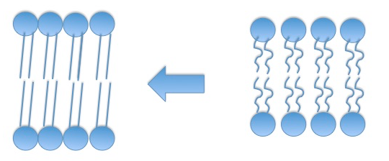
Strategies:
Mechanical
Properties
“Gel”
phase
“Liquid”
phase
Rigid/Solid
Soft/Fluid
Melting Temperature
(T_{m})

Slide 5
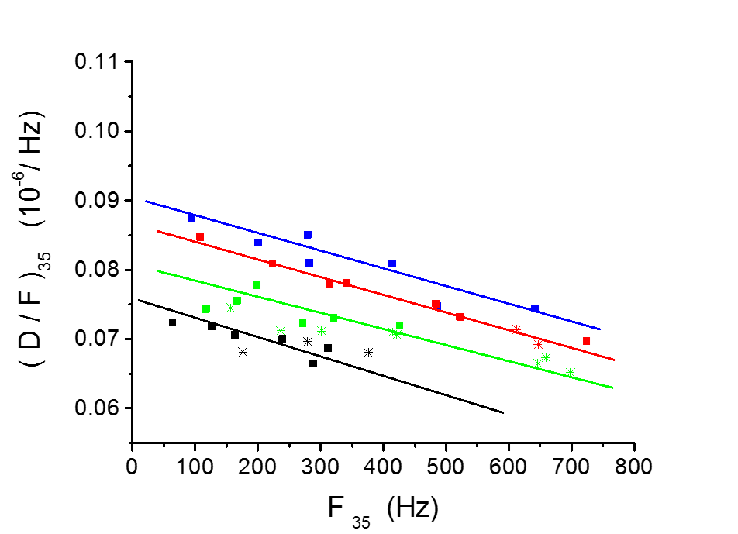
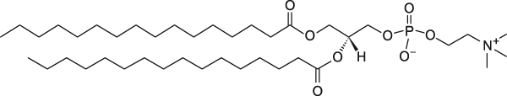
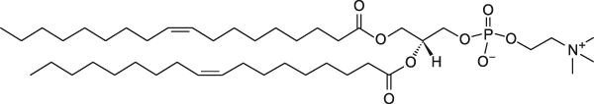
“Mixed” Particles (DOPC:DPPC)
Strategies:
Mechanical
Properties
100 % ???
% DPPC
70 %
50 %
0 %
30 %
DPPC = +41 °C
DOPC = -17 ºC
PROBLEM: Difficult to prepare DPPC 100 %

Slide 6
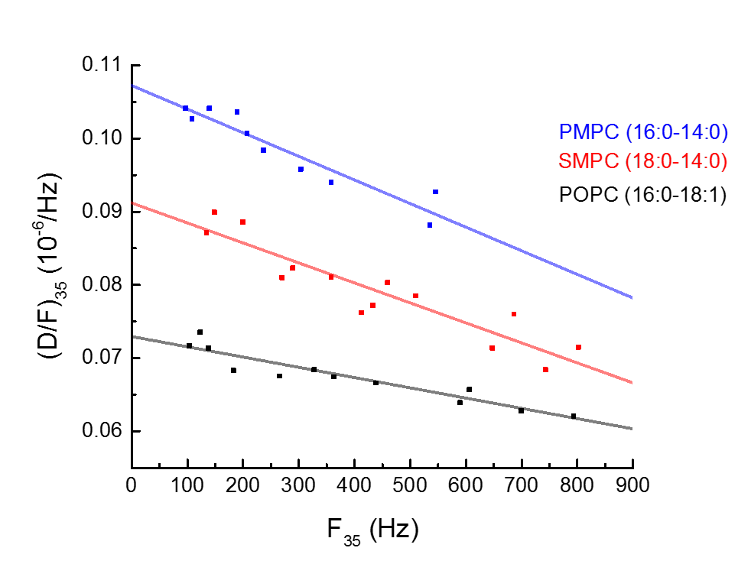
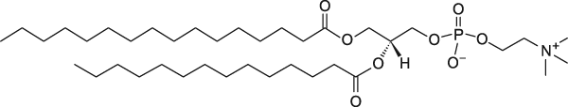
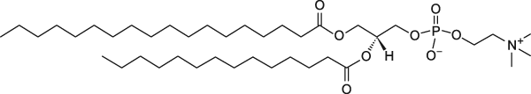
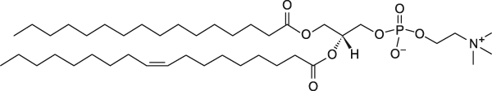
Strategies:
“Pure” Particles
Mechanical
Properties
PMPC = 27 ºC
SMPC = 30 °C
Solution:
Lipid Lower Tm
POPC = -2 °C

Slide 7
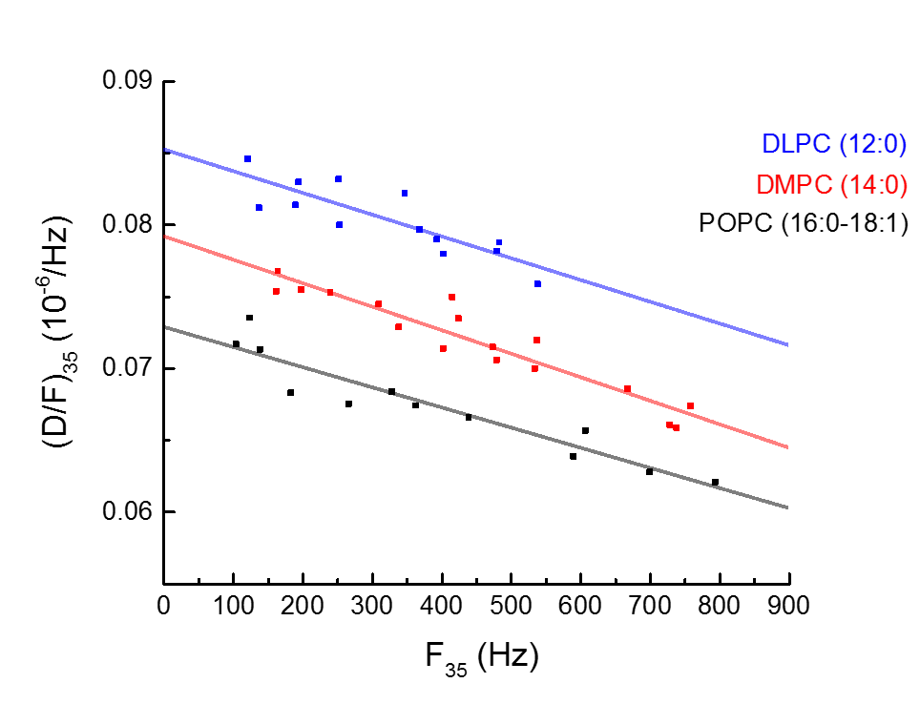
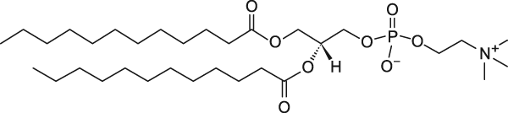
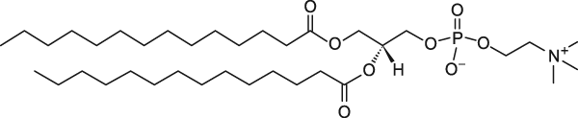
Strategies:
Fatty Acid Length
Membrane
Thickness
Δh
DLPC 3.2 nm*
DMPC
*Neutron Scattering
Kucerka et al
BBA Biomembranes 2011
POPC 3.9 nm*

Slide 8
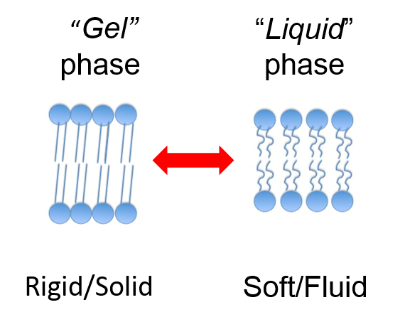
Summary:
(M1-M12): “Mixed” Particles (DOPC:DPPC)
(M12-M18): “Pure” Particles
Mechanical
Properties
Lipid “Gel” Phase is more dissipative
(M12-M18): vs Fatty Acid Length
Thinner Lipid Membranes are more dissipative

Slide 9

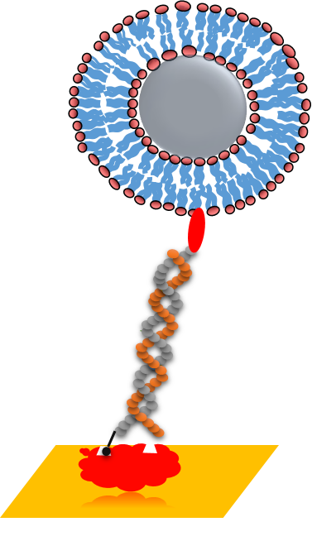
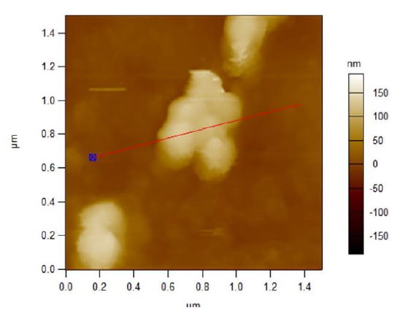
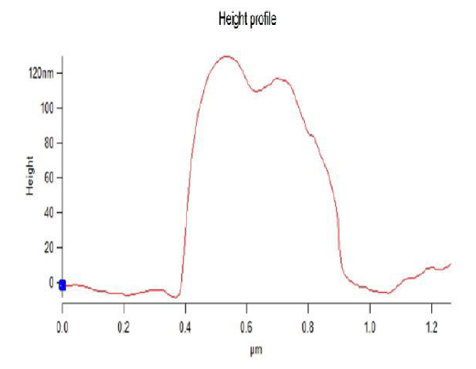
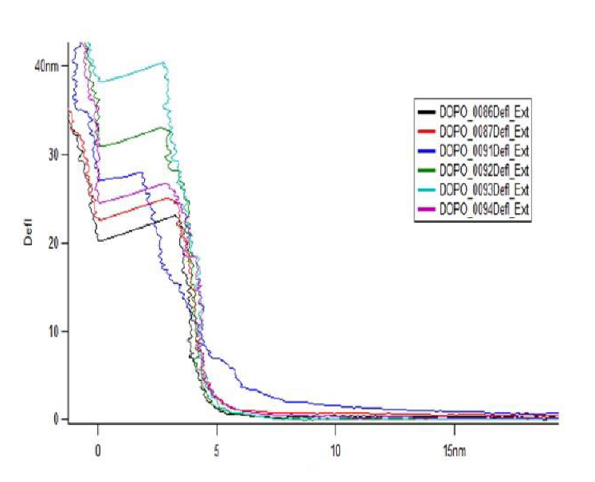
New Particles (BGU)
Silica beads functionalized with
lipid bilayers
Height ∼ 120 nm
Cholesterol
F_z plots
(4 nm indentation)

Slide 10
New Particles (BGU)
Silica beads functionalized with
lipid bilayers
Silica NPs
Liposomes
Cholesterol
0 – 5 Hz
400 – 800 Hz
Particles did not bind cholesterylated DNA

Slide 11
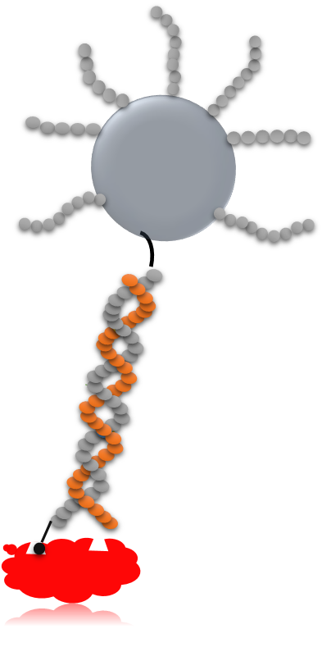
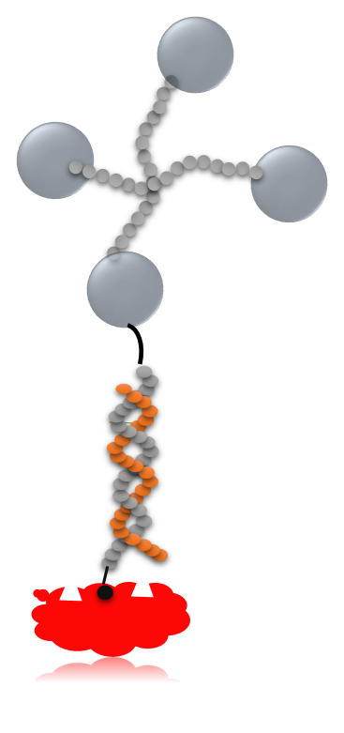
… FUTURE WORK …
BGU Particles

Slide 12

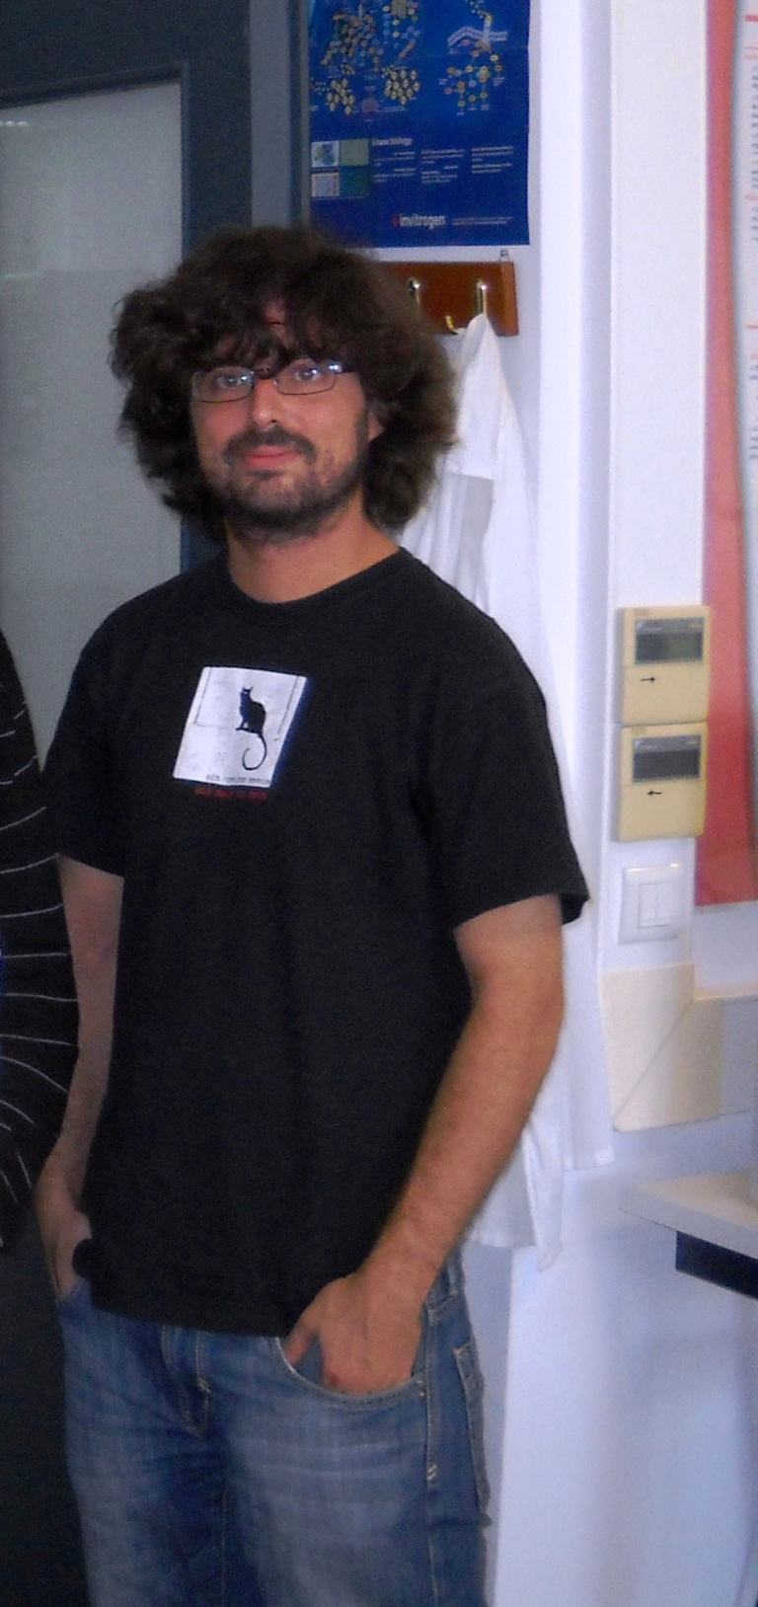
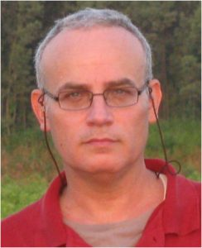

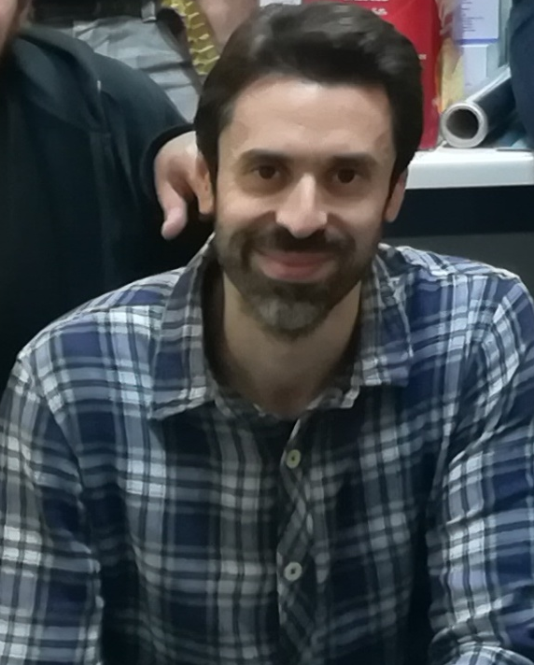
Nikoletta
Dimitra
Pablo
George
Achilleas
THANK YOU

Slide 13
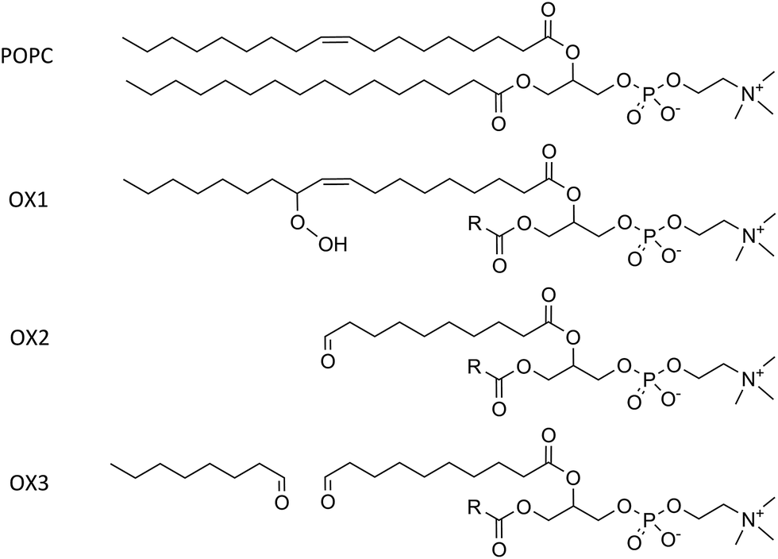
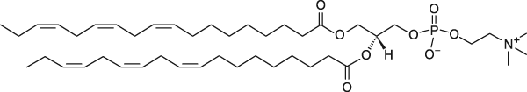
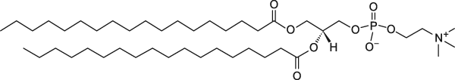
Lipids (Tested M1-M12)
“Pure” Soft Particles
“Mixed” Rigid Particles
18:3
18:1
16:0 / 18:1
16:0
18:0
DLPC
( T_{m} ) - 60 ºC
DOPC
- 17 °C
POPC
- 2 °C
DPPC
+ 41 °C
DSPC
+ 55 °C

Slide 14
Lipids (Tested M12-M18)
“Pure” SoftParticles
vs Membrane Thickness
“Pure” Rigid Particles
12:0
14:0
16:0 / 18:1
16:0-14:0
18:0-14:0
DLPC 3.2 nm
- 2 ºC
DMPC
+ 23 °C
POPC 3.9 nm
- 2 °C
PMPC
+ 27 °C
SMPC
+ 30 °C

